Slide 1
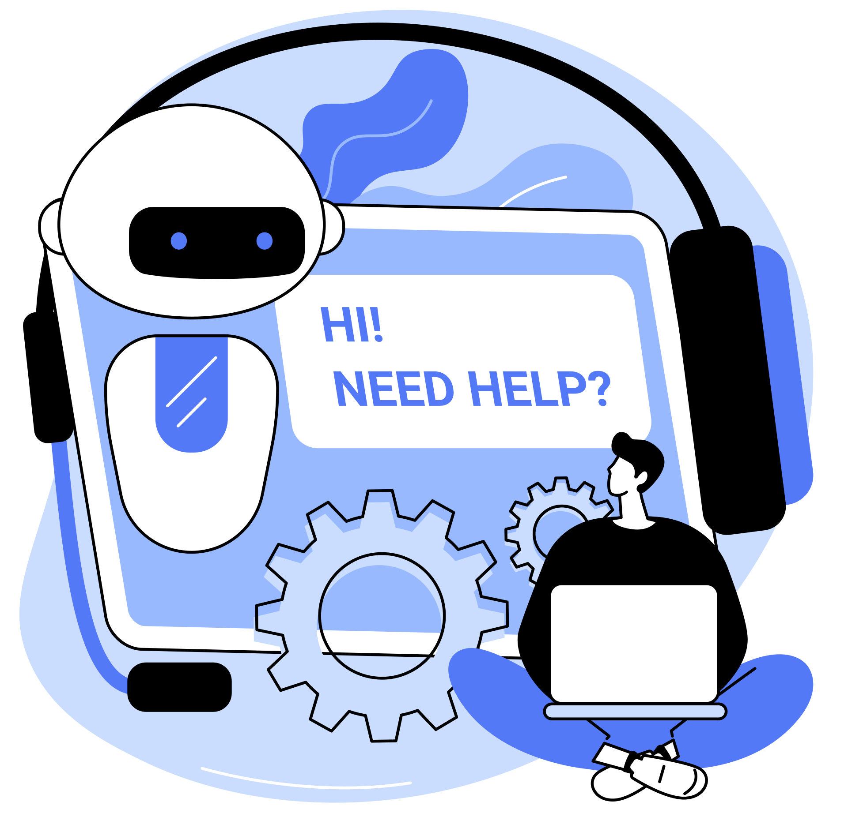
DISTRIBUTED CLOUD COMPUTING

Slide 2
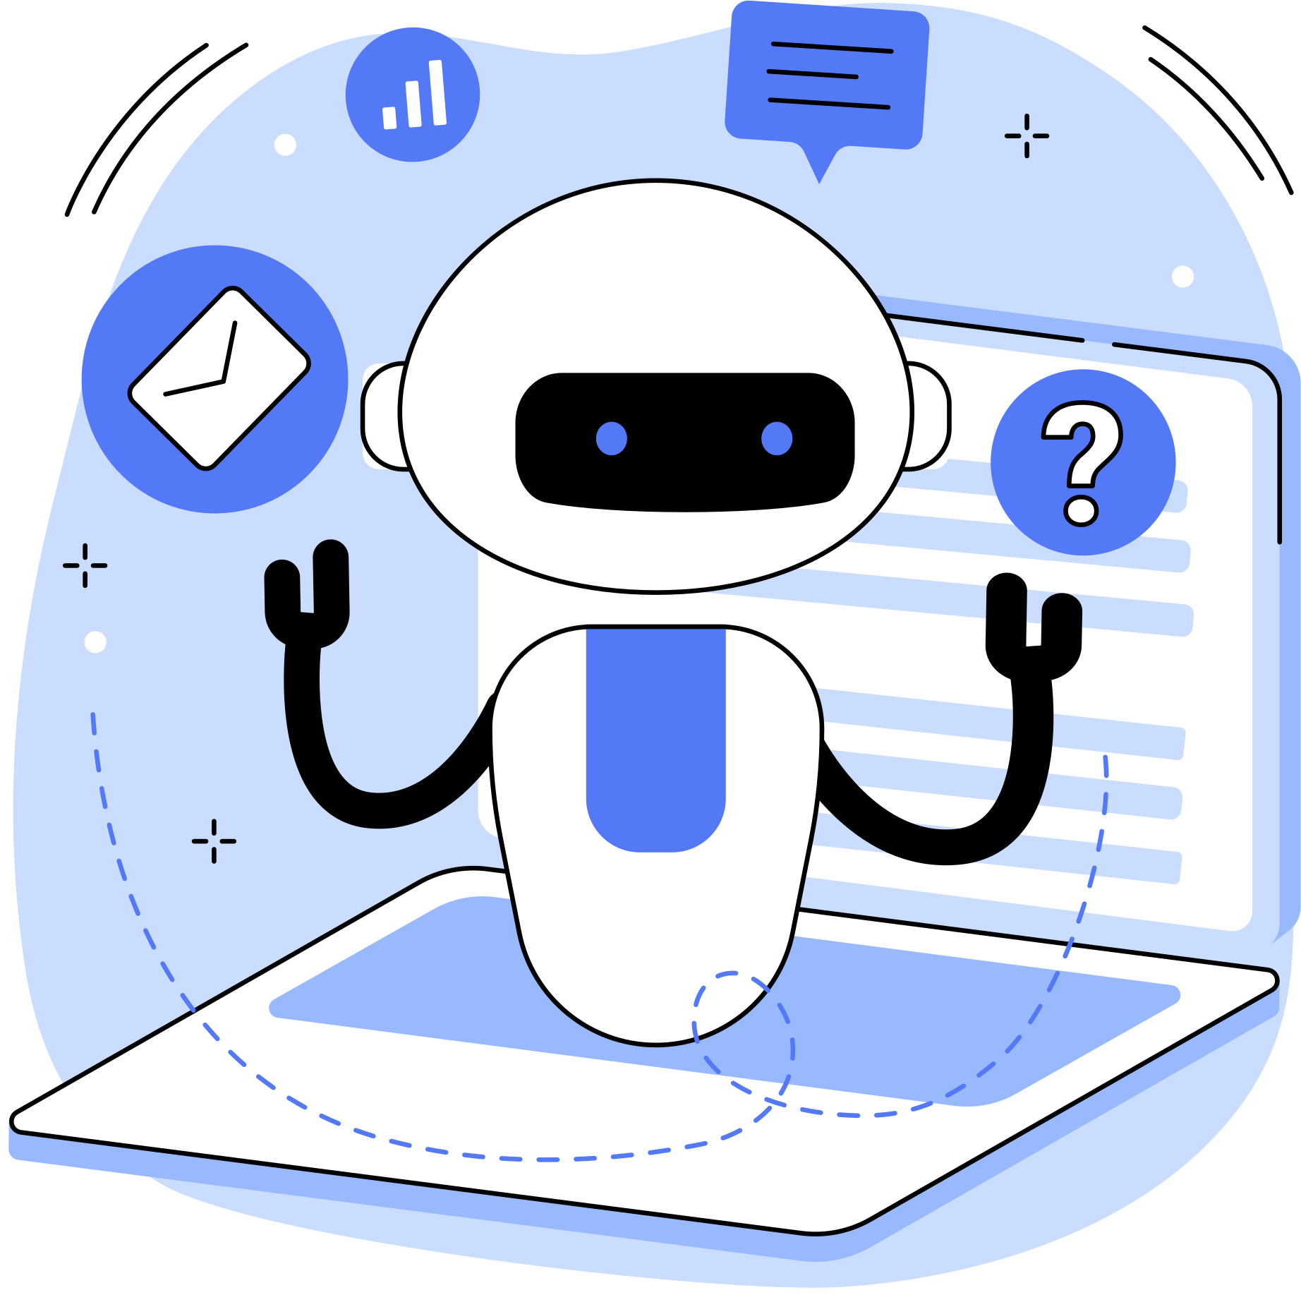
distributed computing
The concept of distributed cloud computing is a part of cloud computing systems in which the computing resources and software applications are located at different cloud service providers or servers but they act under one cloud computing software for operating and managing the resources across multiple cloud platforms.

Slide 3
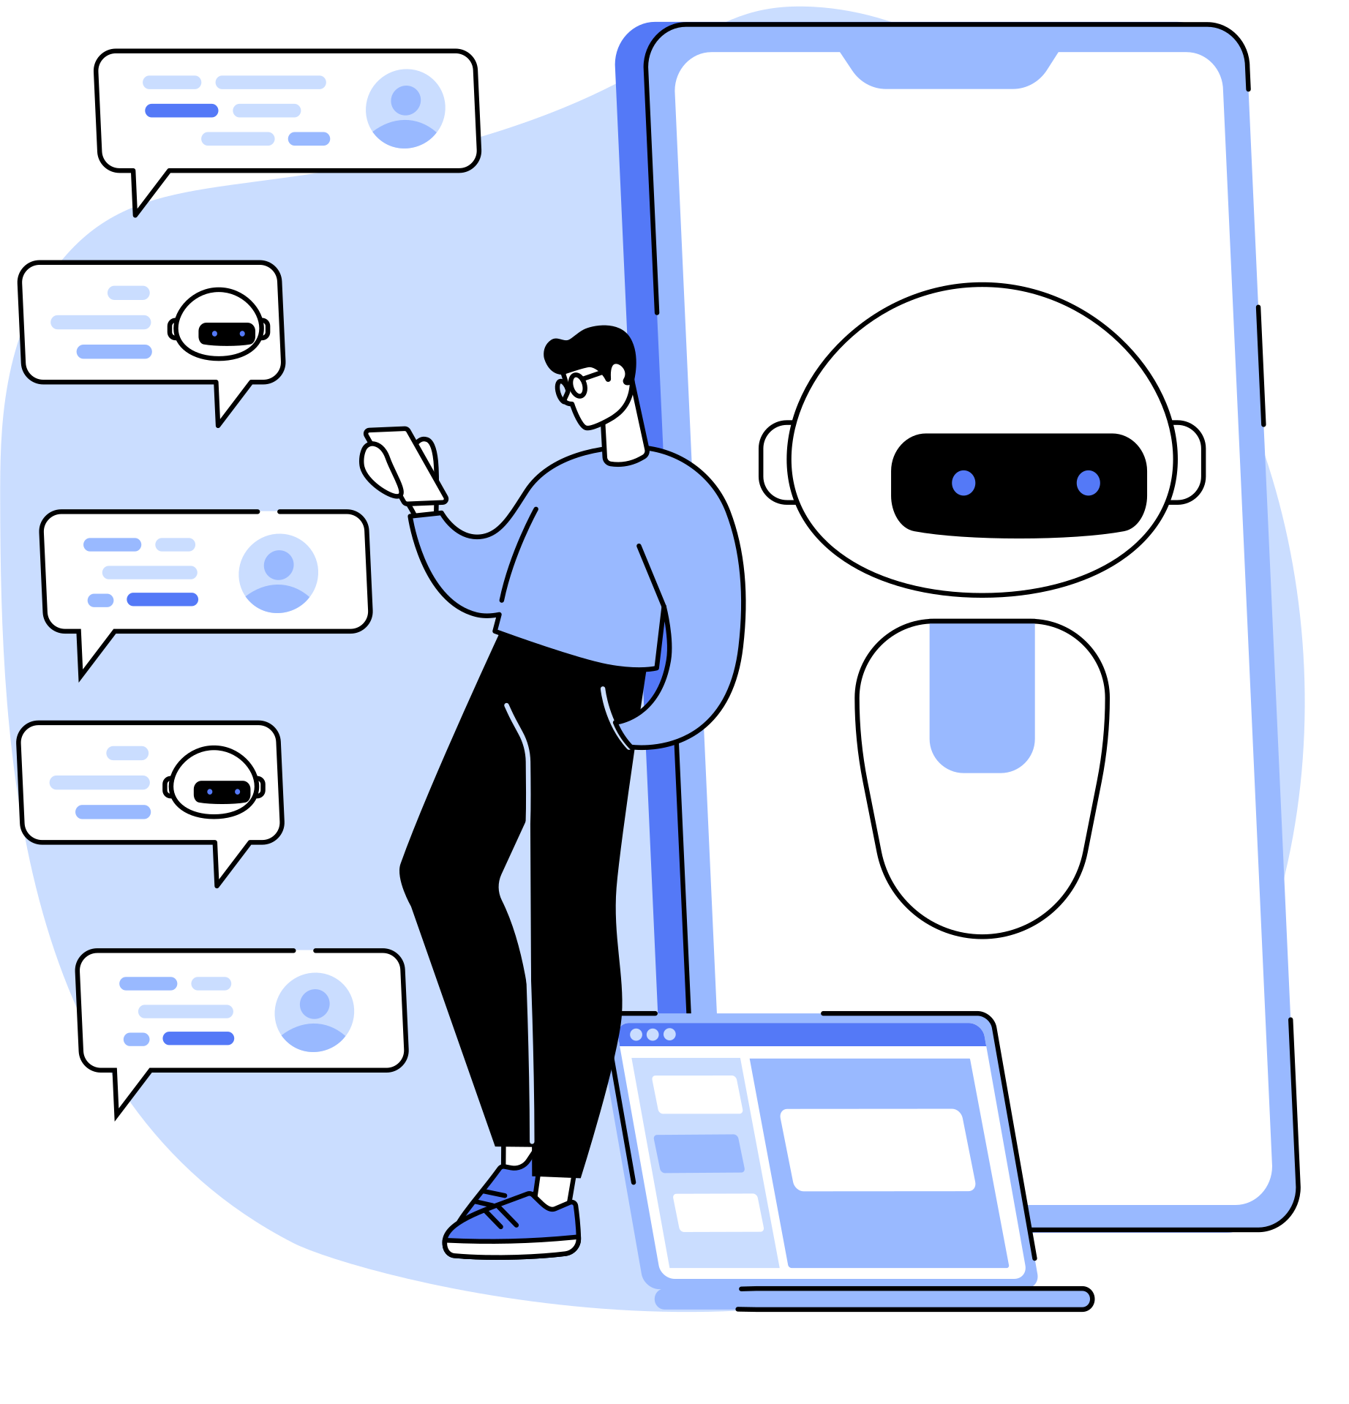
edge cloud computing
The concept of edge cloud computing is somewhat similar to the distributed cloud computing environment. In edge computing, the real-time data or content service is provided to the end-users at the edge of the environment very close to the end-users.

Slide 4
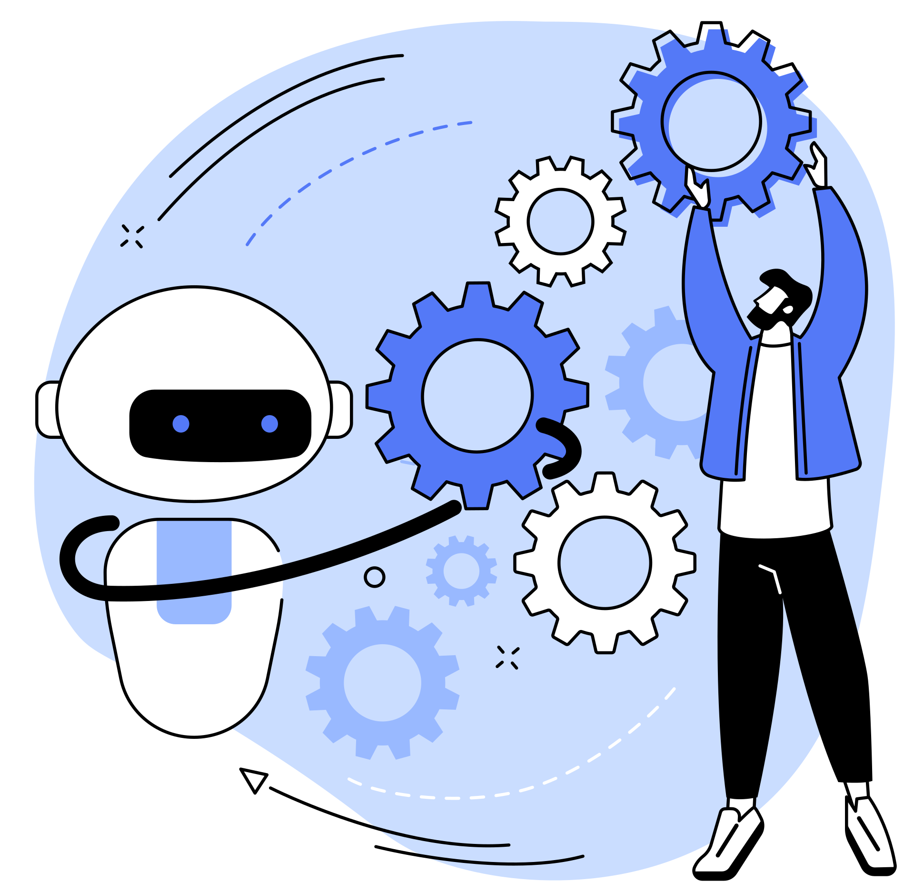
advantages of cloud computing
Regulatory compliances
Flexibility—
Enhanced performance
Scalability
Faster processing
Greater uptime
Security

Slide 5
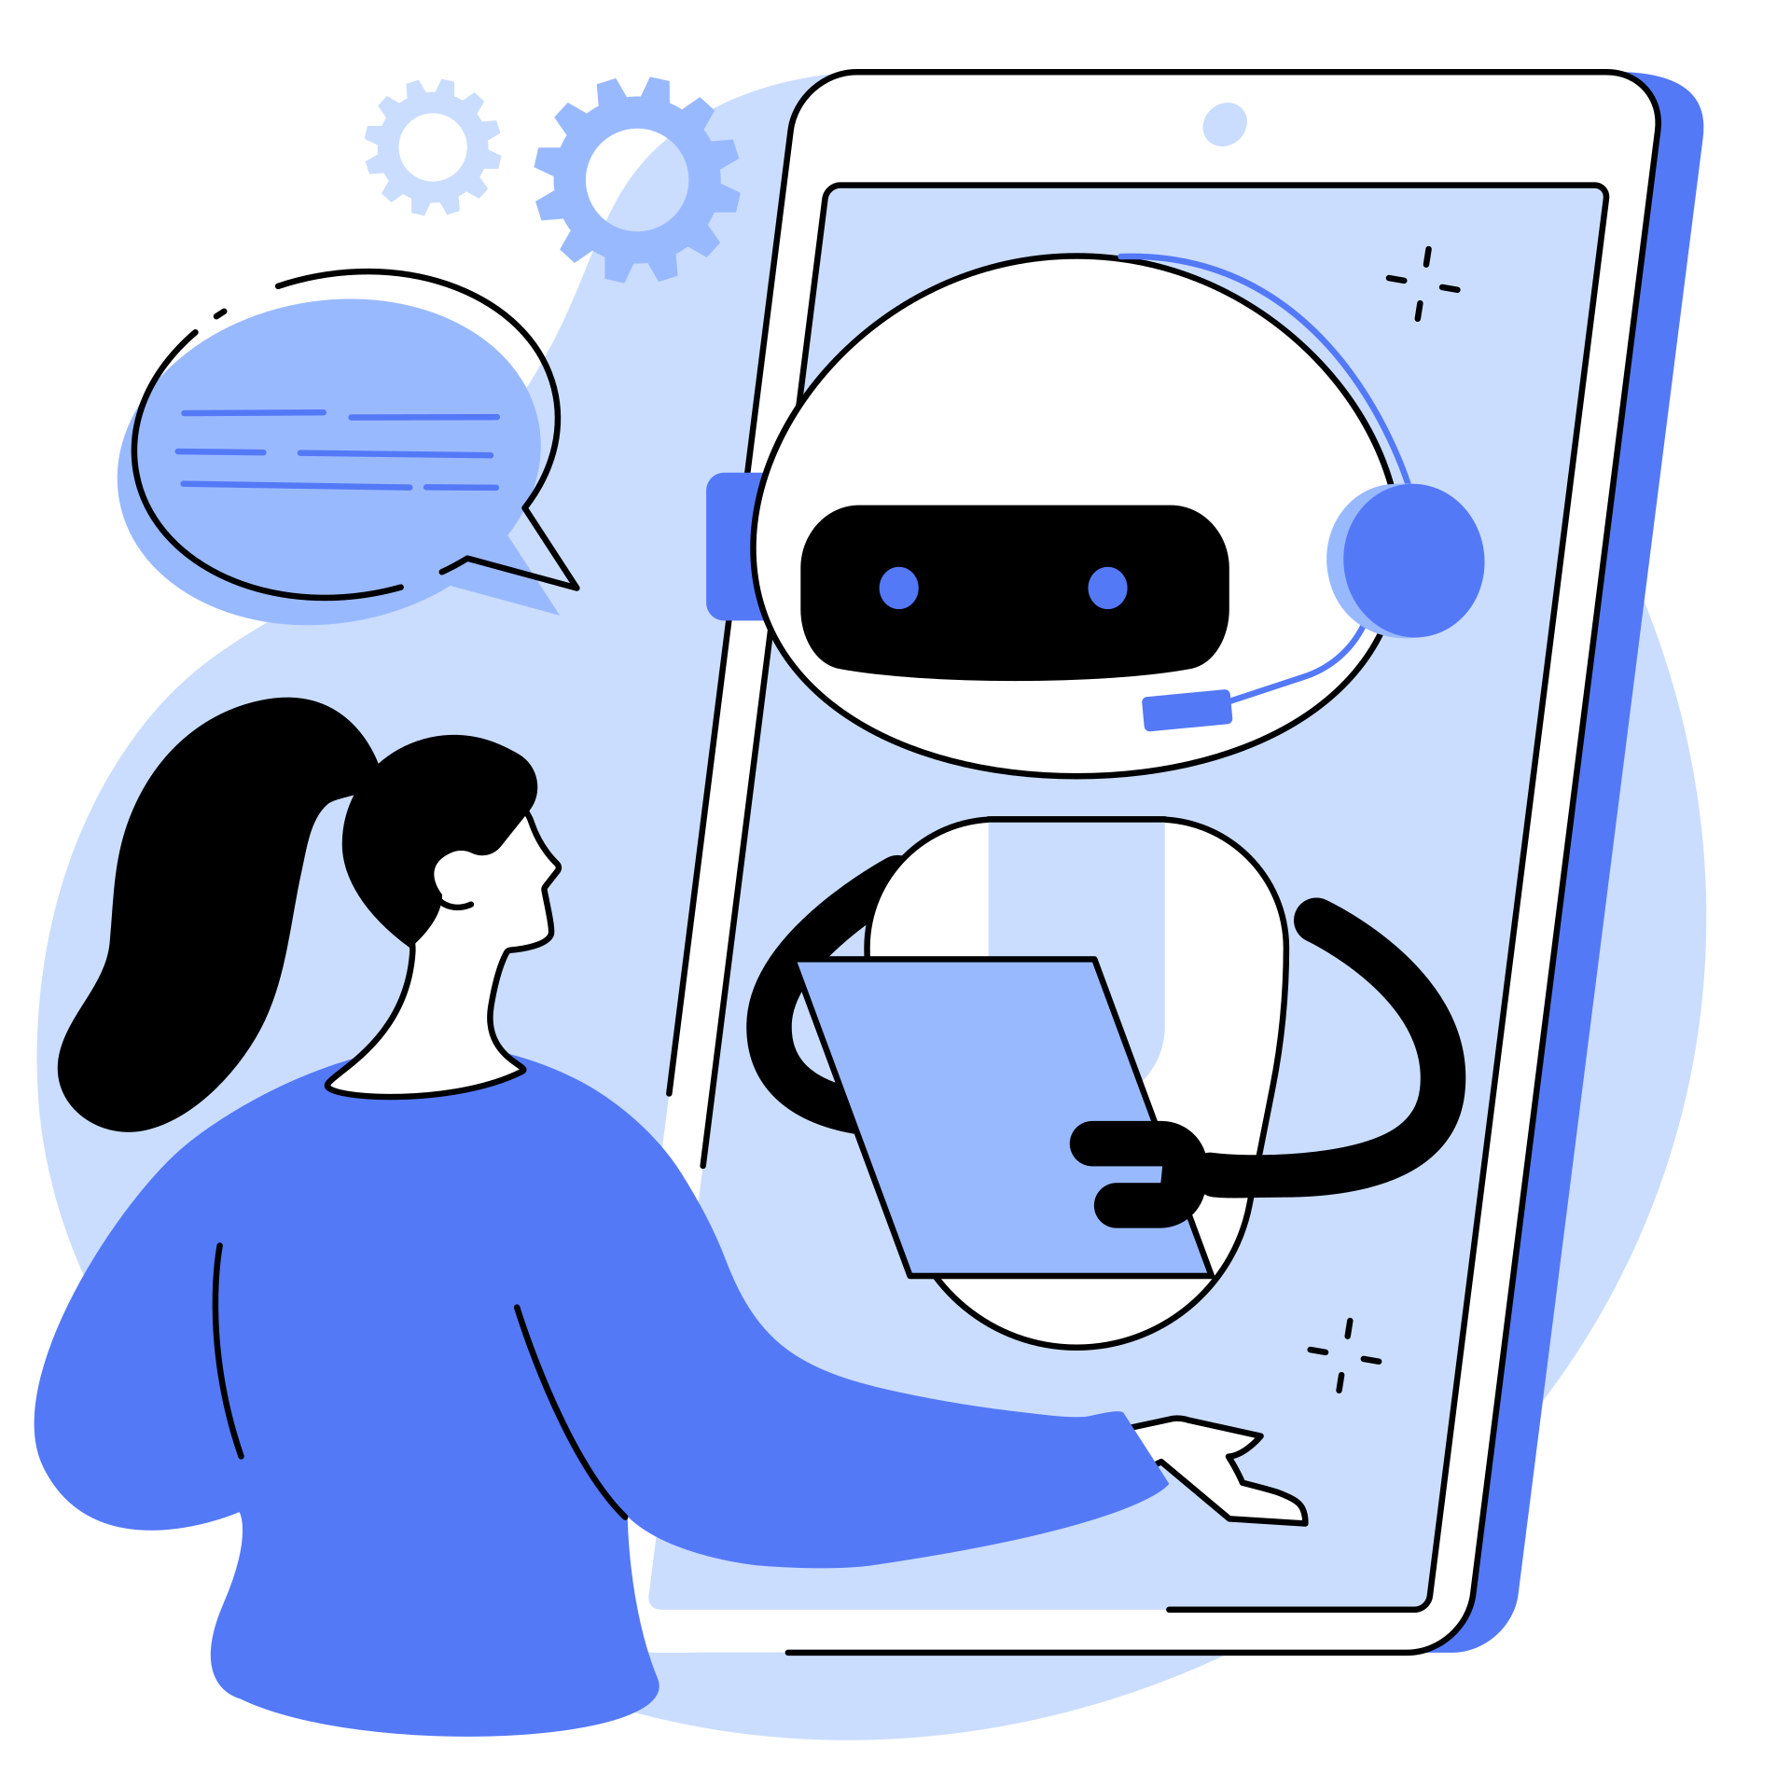
Working Principle of Distributed Cloud
The basic working principle of distributed cloud computing is to distribute or split one single task among a number of virtual machines located at different locations to provide faster processing, greater efficiency, and reduced latency in the network.

Slide 6
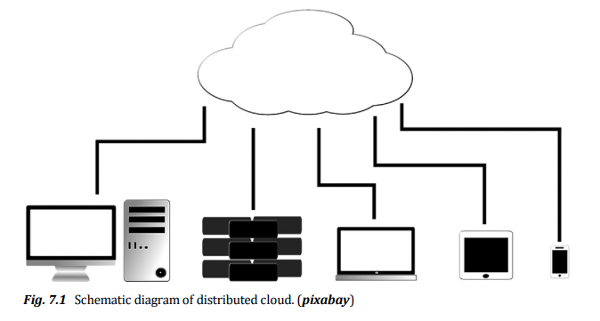
Distributed Cloud Architecture
The distributed cloud computing system architecture can be further divided into four classes based on the software systems as listed below:
Layered architecture
Data-centered architecture
Event-based architecture
Object-based architecture.

Slide 7
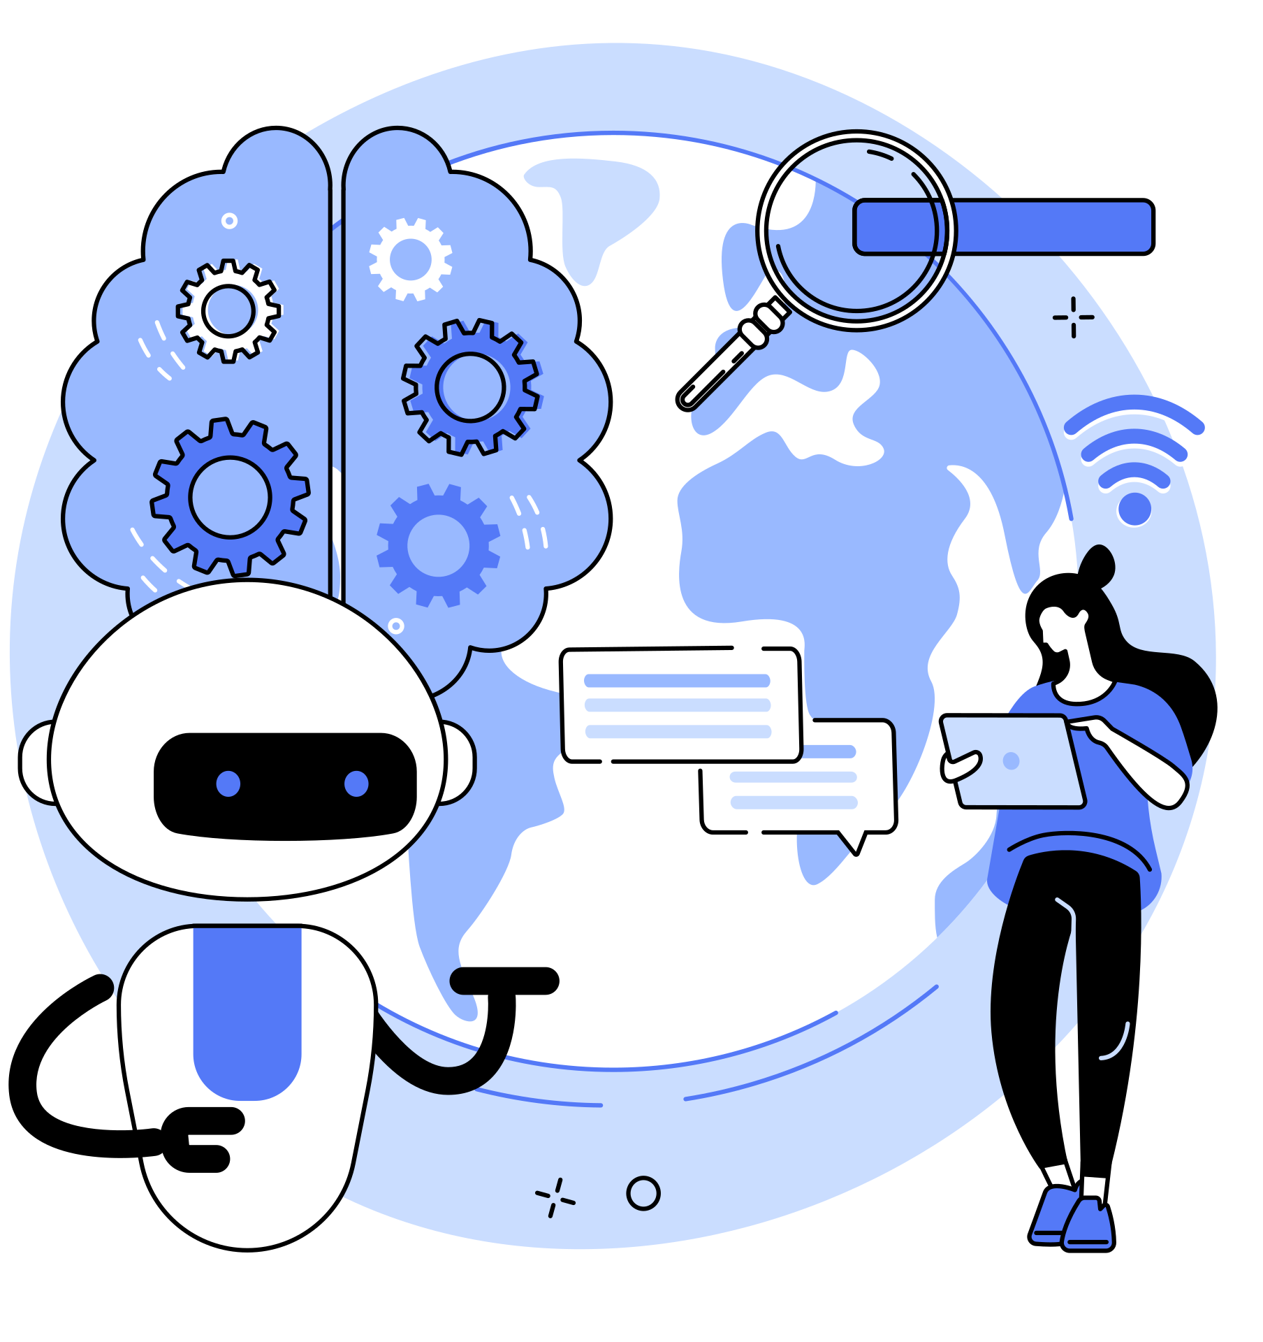
Top Use Cases of Distributed Cloud in Industries
1
Content Delivery Network (CDN)
2
Internet of Things (IoT) and Edge
3
Software Defined Infrastructure (SDI)
4
Big Data Processing
5
Multi-Cloud Unification
6
Centralized Management

Slide 8
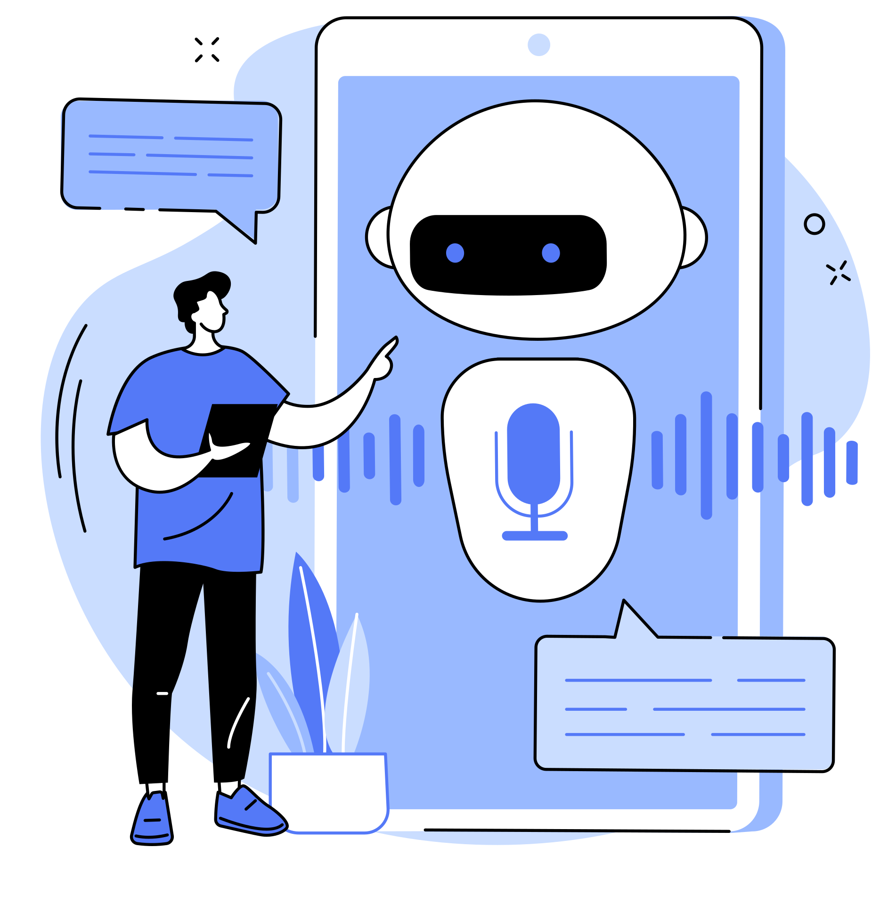
Content Delivery Network (CDN)
Content delivery network (CDN) is a network of proxy servers that are situated at different geographical locations in such a way that they provide the content very fast by reducing the distance of content to be loaded from the main server located at very remote location.

Slide 9
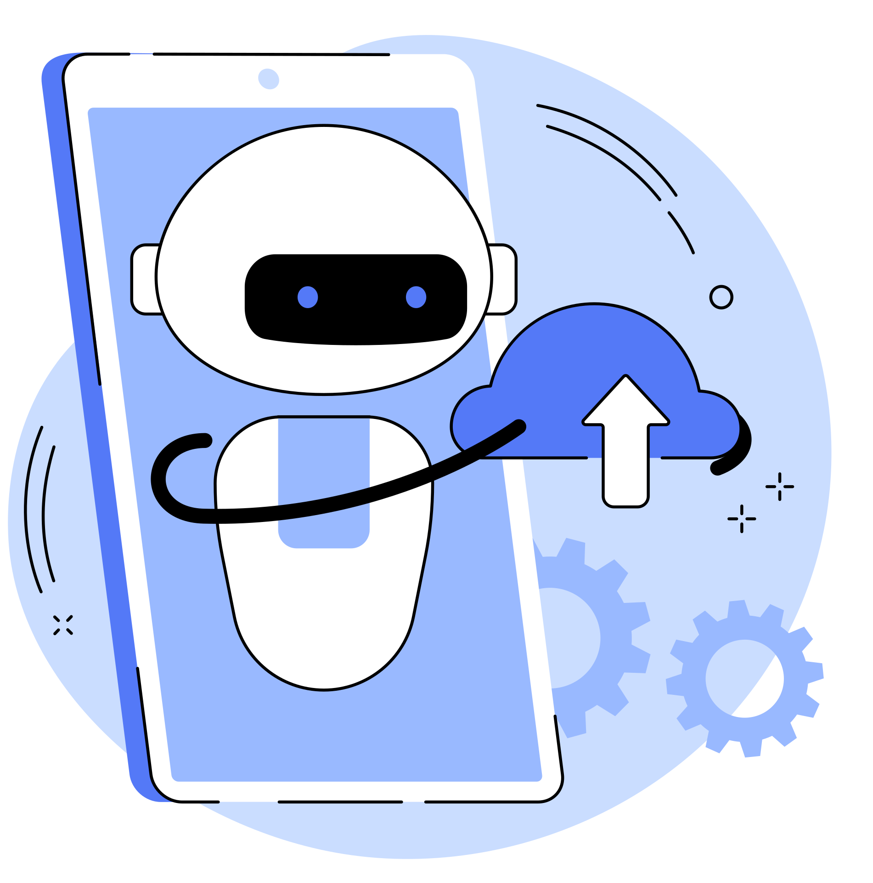
Internet of Things (IoT) and Edge
The IoT and edge computing are other major usage scenarios that require the power of distributed cloud computing technology. The details of IoT and edge cloud computing have already been provided in the previous chapter

Slide 10
Software Defined Infrastructure (SDI)
The control of hardware-based computing resources such as storage, memory, processors, networking, and allied equipment through software platform is referred to as software defined infrastructure. The concept of cloud computing through virtualization of computing resources is an example of software defined infrastructure.

Slide 11
Big Data Processing
The most important sources for generating the big data include machine generated data, especially in IoT environment, digital transactional data, and social media platforms.

Slide 12
Multi-cloud Uniication
The unification of multi-clouds is designed to use the power of distributed computing system, especially the edge computing to process the data from the major data sources efficiently and quickly.

Slide 13
Centralized Management
Centralized management of company resources, processes, and stakeholders is referred to as centralized management in modern field of IT terminology.

Slide 14
Challenges of Distributed Cloud Computing
Complexity
Security
Contingency
Bandwidth
Transparency
Technical faults
Troubleshooting

Slide 15
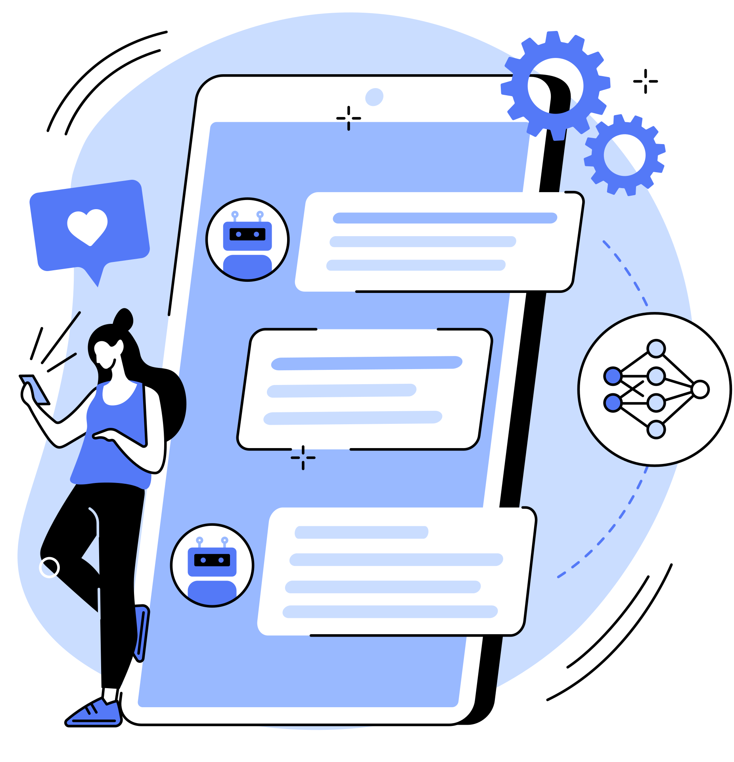
THANK YOU FOR LISTENING!

